Slide 1

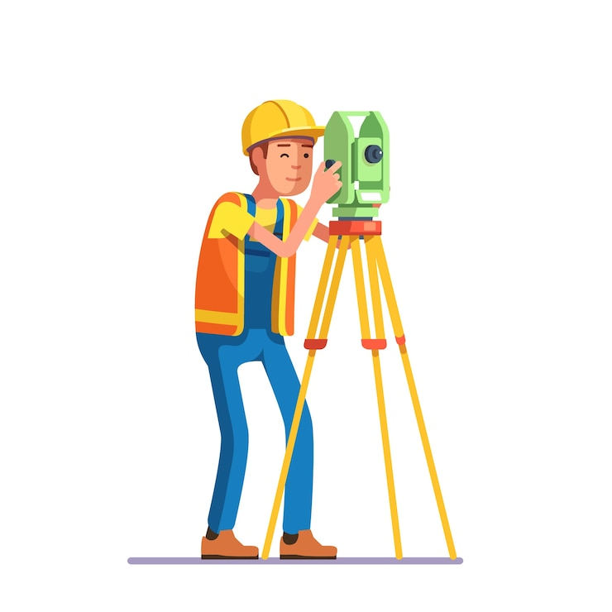
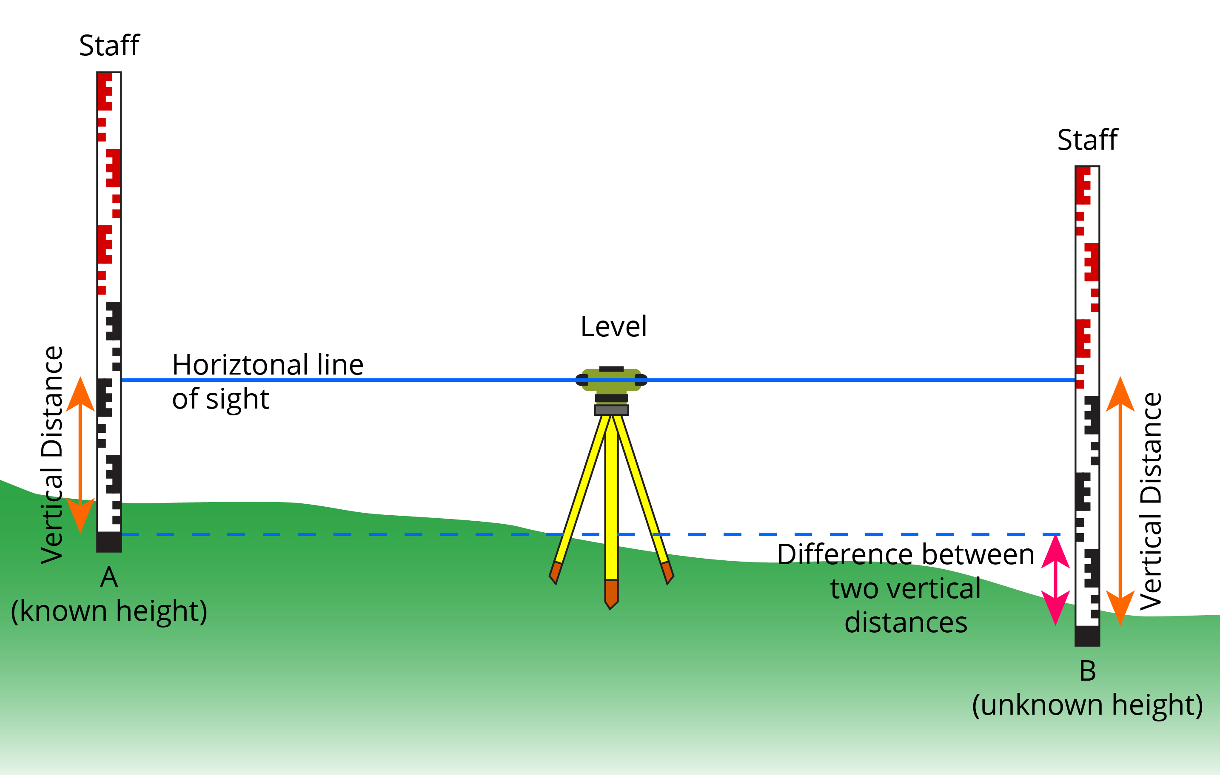
Geologic methods
Department of Earth Sciences Institute for Geological Sciences
AG Tectonics & Sedimentary Systems
Intro to Geodesy
Summer Semester 2025
Dr Hannah Sophia Davies
h.davies@fu-berlin.de

Slide 2
Couplet teaching
Group A
Group B
Labs Wednesday mornings
10:00 – 12:00 (T Building)
GIS Wednesday mornings
10:00 – 12:00 (B032)
Alternate Labs and GIS each week
Labs Wednesday mornings
10:00 – 12:00 (T Building)
GIS Wednesday afternoons
12:00 – 14:00 (G107)
Alternate Labs and GIS each week

Slide 3
Where are you right now?
You’ve heard of Alex’s
“Was ist das?”
Now get ready for Hannah’s
“Wo ist das?”
What is your latitude and longitude?
What datum is that? – phones (Google maps) use WGS 84
What elevation are you?
Notes:
52.42749, 13.35700, 48m

Slide 4
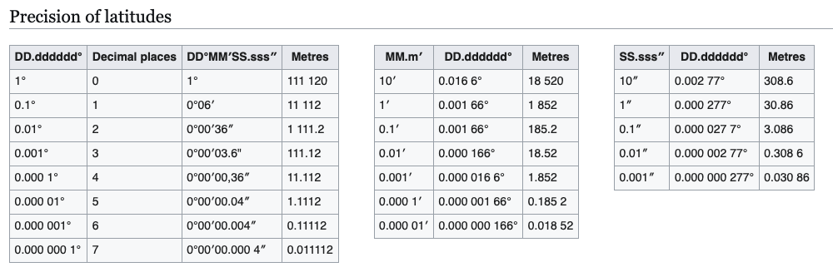
Precision of WGS84
One minute of latitude (or longitude) at the equator is one nautical mile

Slide 5
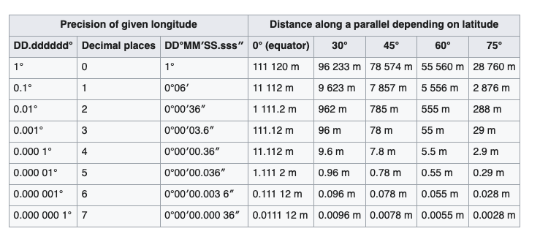
Precision of WGS84
Precision of Longitude
The precision of longitudes is dependent on the latitude : the higher the latitude, the closer the meridians are to each other.
The value in meters is to be multiplied by the cosine of the latitude (except along the equator). So, for example, in Germany (50 ° N) the meridians are about 2/3 as large as on the equator and the accuracy is correspondingly higher.

Slide 6
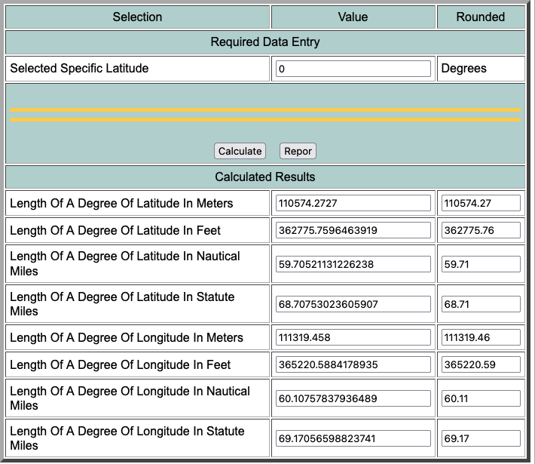
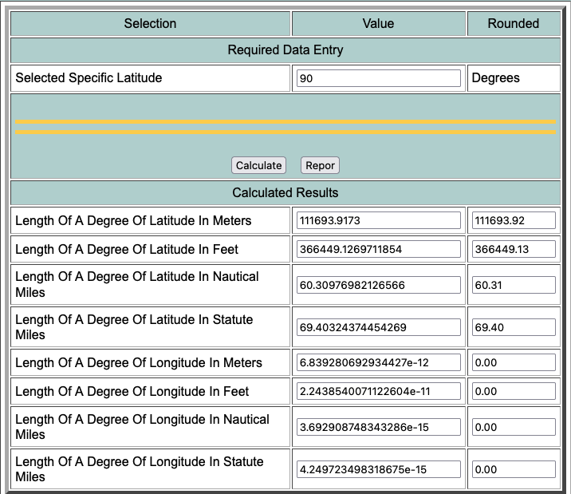
http://www.csgnetwork.com/degreelenllavcalc.html
Equator
40075 km/360° = 111.319 km
Pole

Slide 7
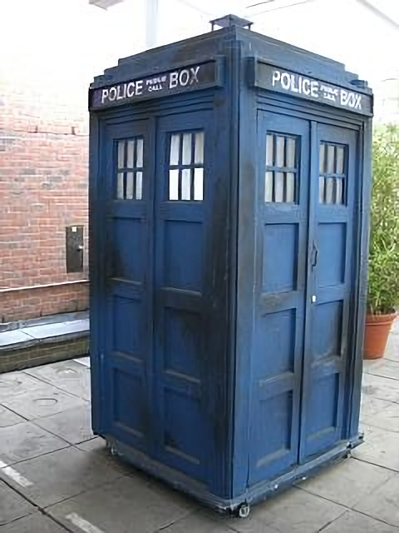
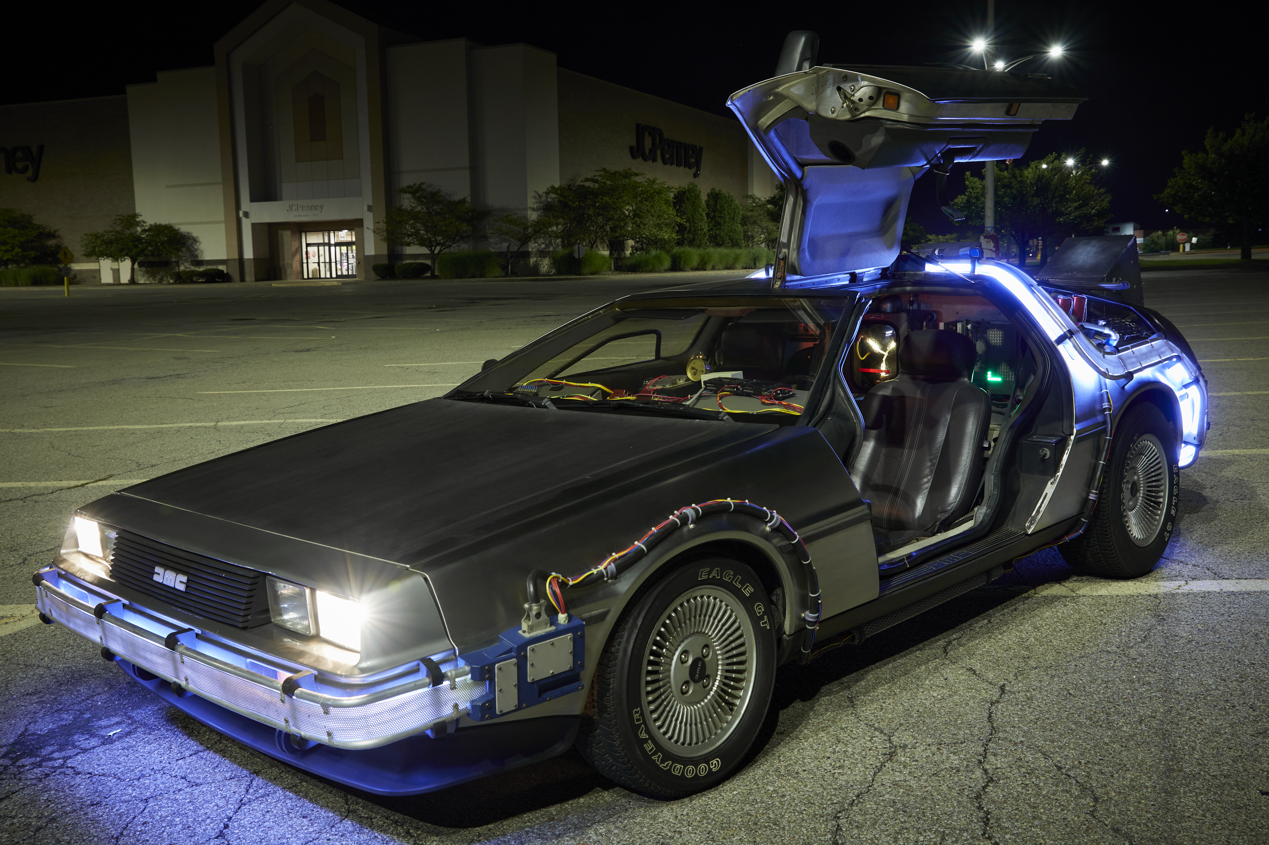
Notes:
Wells’ time machine only goes through time, you need something that also goes through space.

Slide 8
When on a planet latitude and longitude makes sense to use for positioning
Latitude = angle from equator
Longitude = angle relative to abitrary “0°” prime meridian or Greenwich meridian
Lats and longs are in base 60. There is 360° in a circle
Divisions of lats and longs are minutes and seconds of arc – also base 60
53° 13’ = 53 degrees and 13 minutes
13/60 = 0.2166 so in Decimal degrees it would be 53.2166°

Slide 9
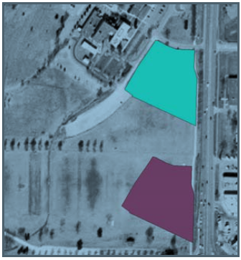
Assuming the wrong datum (Terrestrial reference system) can have consequences!
Different datums – which is correct?
This gets more complicated when there are multiple datasets/data layers
Be careful about datums!
Especially if it is a field of landmines
Why are these two datums so different?

Slide 10
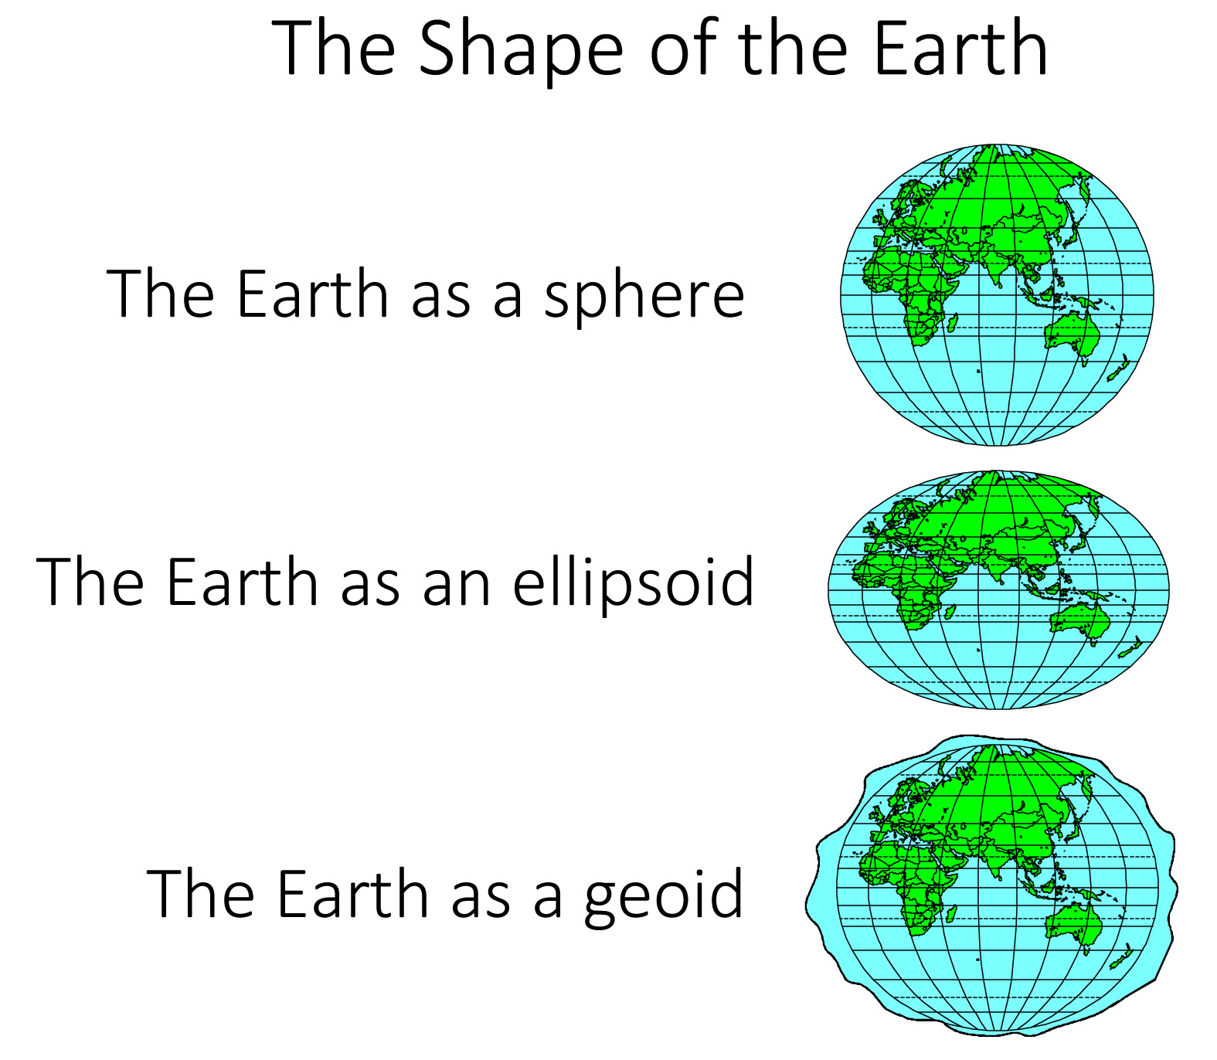
Best approximation
(of the whole globe)

Slide 11
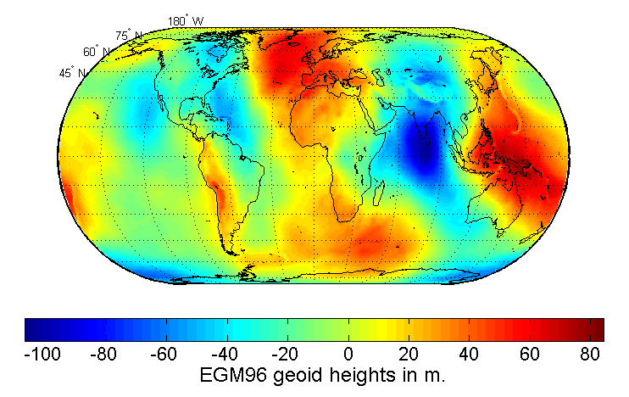
WGS 84 is the ellipsoid that best fits the geiod
It is not the first!
It is not perfect!
It is the best if you want to do global mapping (or don’t have a regional datum at hand)
Generally for Europe you will be above the WGS 84 ellipsoid
It doesn’t matter if you are wrong, as long as you are consistenly wrong and know how wrong you are.
Map of the undulation of the geoid in meters (based on the EGM96 gravity model and the WGS84 reference ellipsoid).

Slide 12
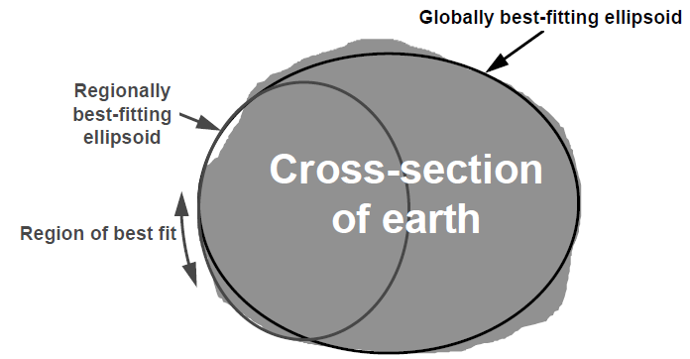
Geoid and Ellipsoid
If you want to be more precise you should use a regionally best fitting ellipsoid that has a good fit in a specific place.

Slide 13
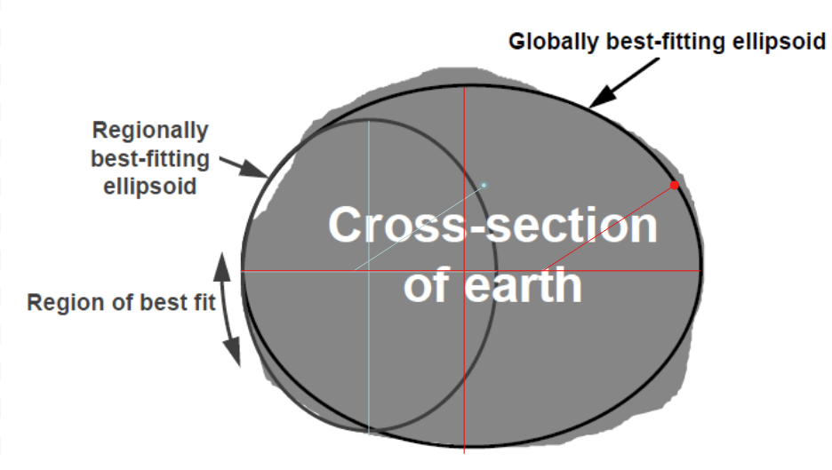
How positions change based on Datum
The same latitude and longitude can put you in different locations for different datums

Slide 14
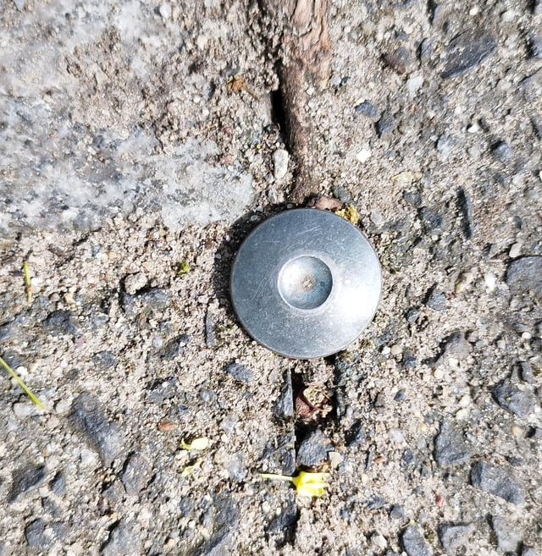
What about elevation?
Notes:
Vermessungspunkt
https://de.wikipedia.org/wiki/Vermessungspunkt

Slide 15
What about elevation?
The OG way to do it
Use a surveying staff and a Theodolite
Go stepwise up or down measuring vertical distance each time
This gives you an elevation above the reference point for all points measured

Slide 16
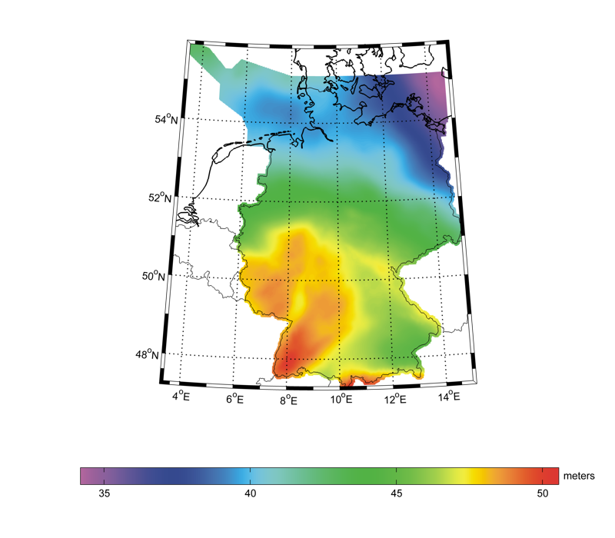
GCG2016 German geoid model
Notes:
G. Liebsch, U. Schirmer, J. Ihde, H. Denker, J. Müller (2006). Quasigeoidbestimmung für Deutschland. Deutscher Verein für Vermessungswesen - Schriftenreihe, 49, pp. 127-146. J. Schwabe, G. Liebsch, U. Schirmer (2016). Refined computation strategies for the new German Combined Quasigeoid GCG2016. Symposium on Geoid, Gravity and Height Systems (GGHS2016). 19-23 September 2016, Thessaloniki, Greece.

Slide 17
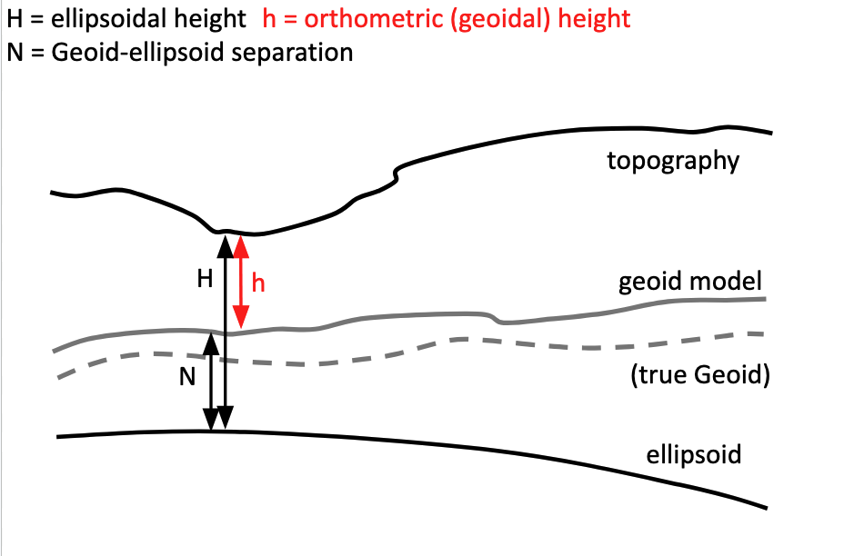
Sometimes the ellipsoid is way off…
Notes:
So most people will use relative elevation above a local geoid. Which is effectively sea level.

Slide 18
Summary
Always check your datum! – We use An ellipsoid Earth to try to account for its oblate spheroid shape
Regional datums may be more precise
You will always have to account for local geoid to calculate your true elevation
Remember that a lot of spherical calculations rely on base 60 calculations

Slide 19
Next week
First GIS session
Using python and jupyter notebooks to plot and understand geospatial data
Remember your group!

